Slide 1


Introduction:Ecobox New Arrival Display
Plastic Cabinet/Iron Stand

Slide 2
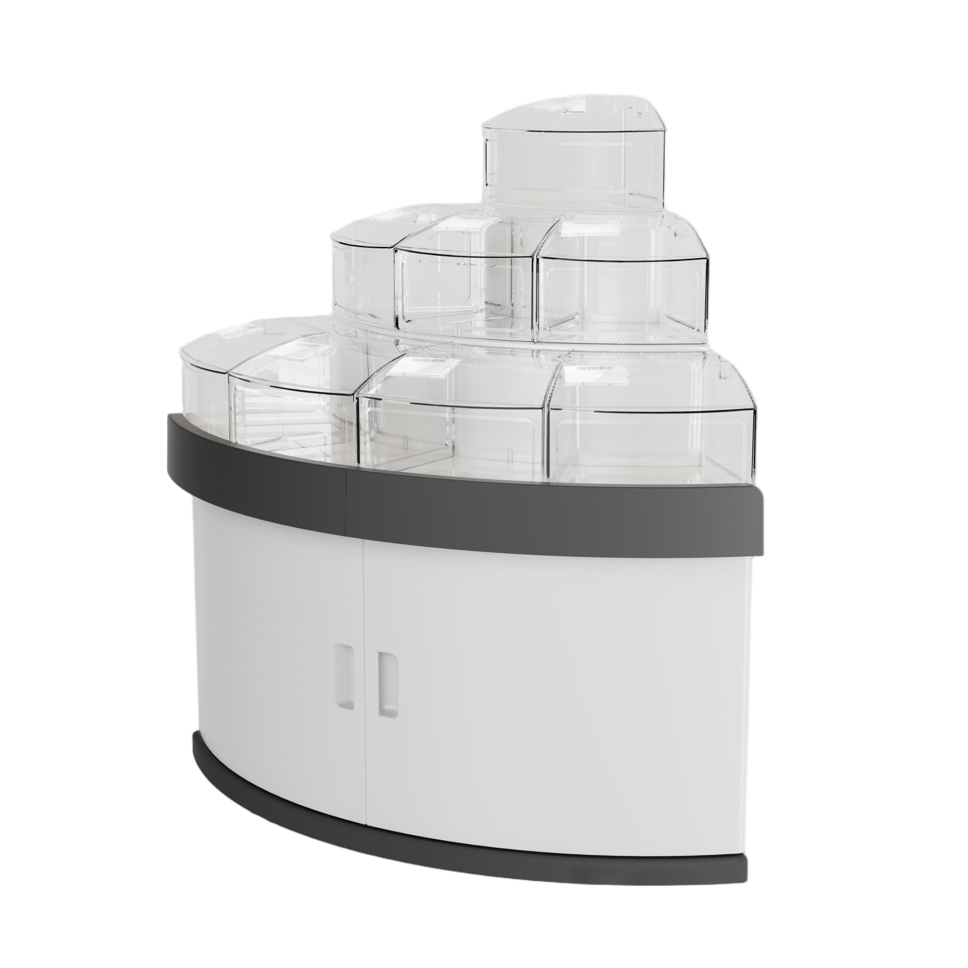
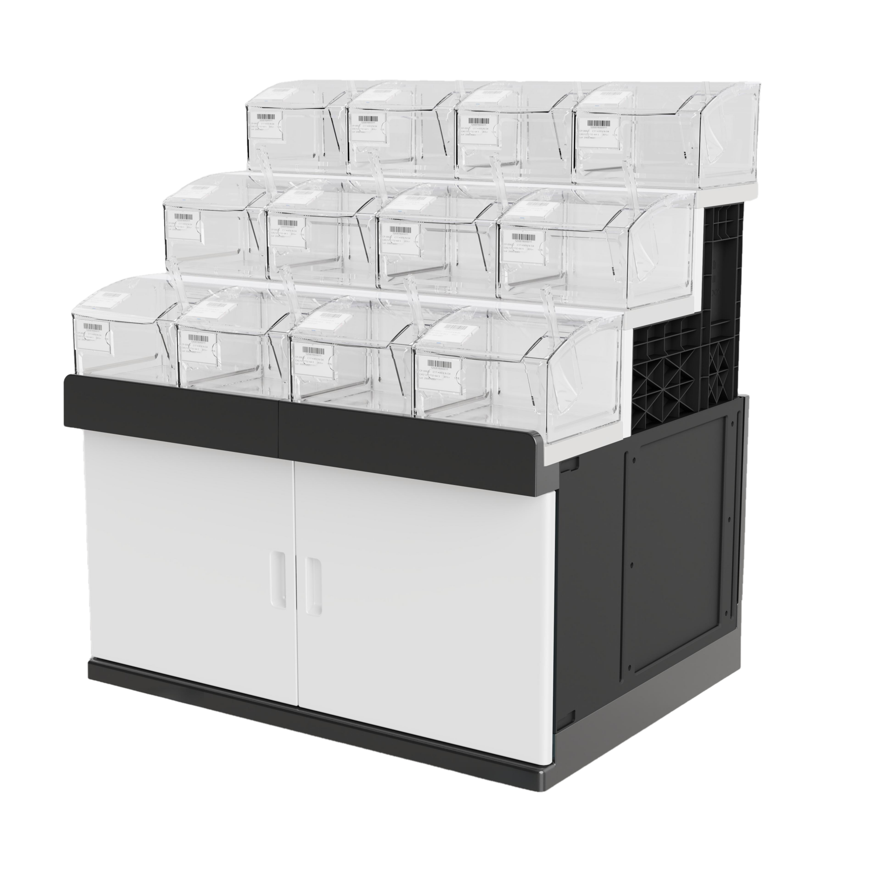
Single Plastic Display Cabinet
GT-01
Square-shape/Middle-position Cabinet
GT-02
Arc-shape/Side-position Cabinet

Slide 3
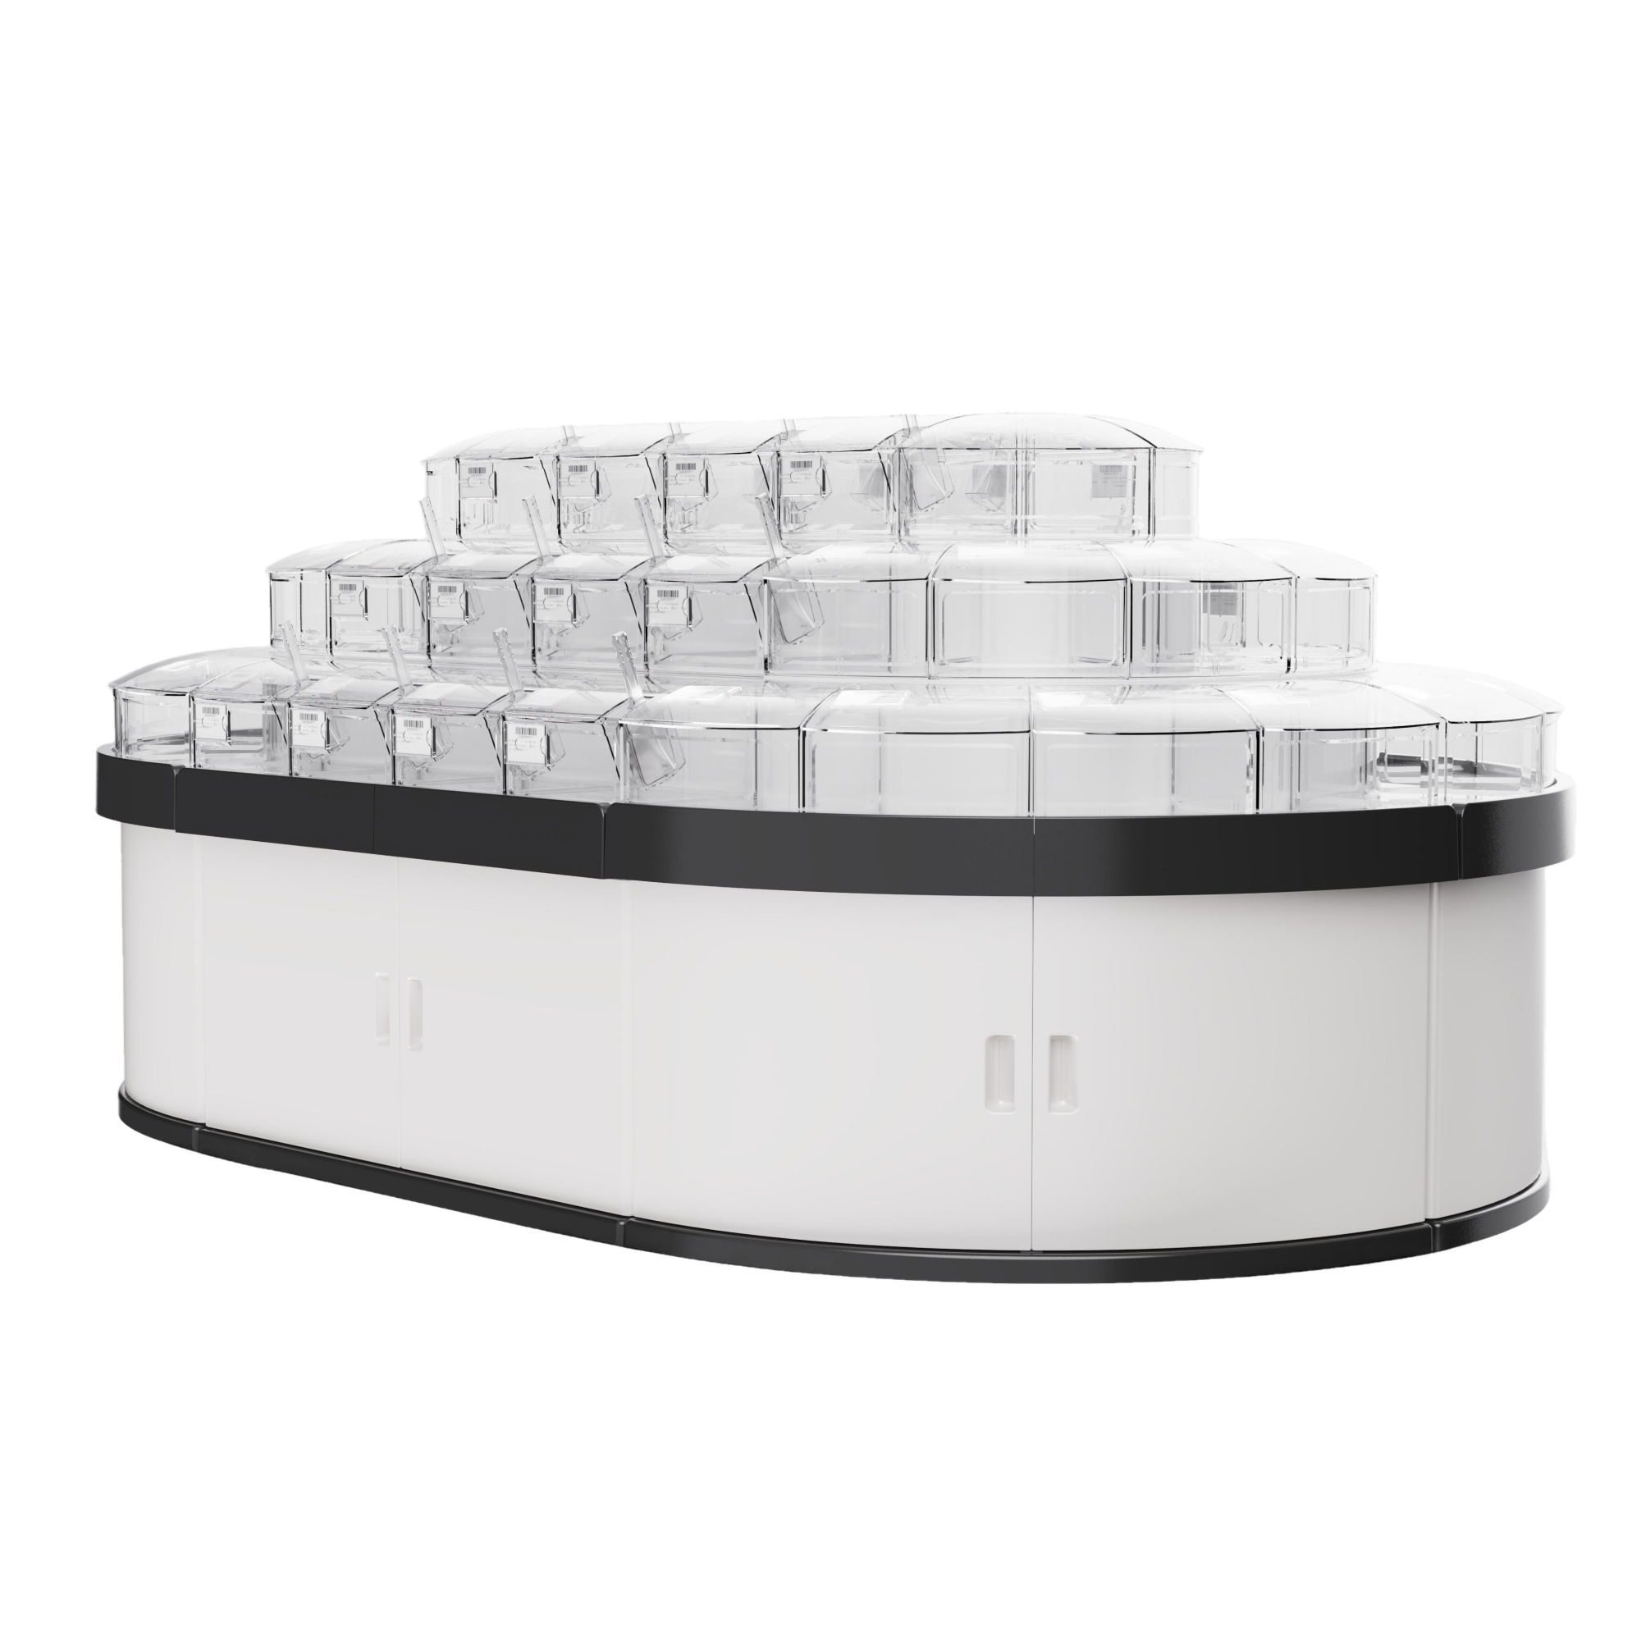
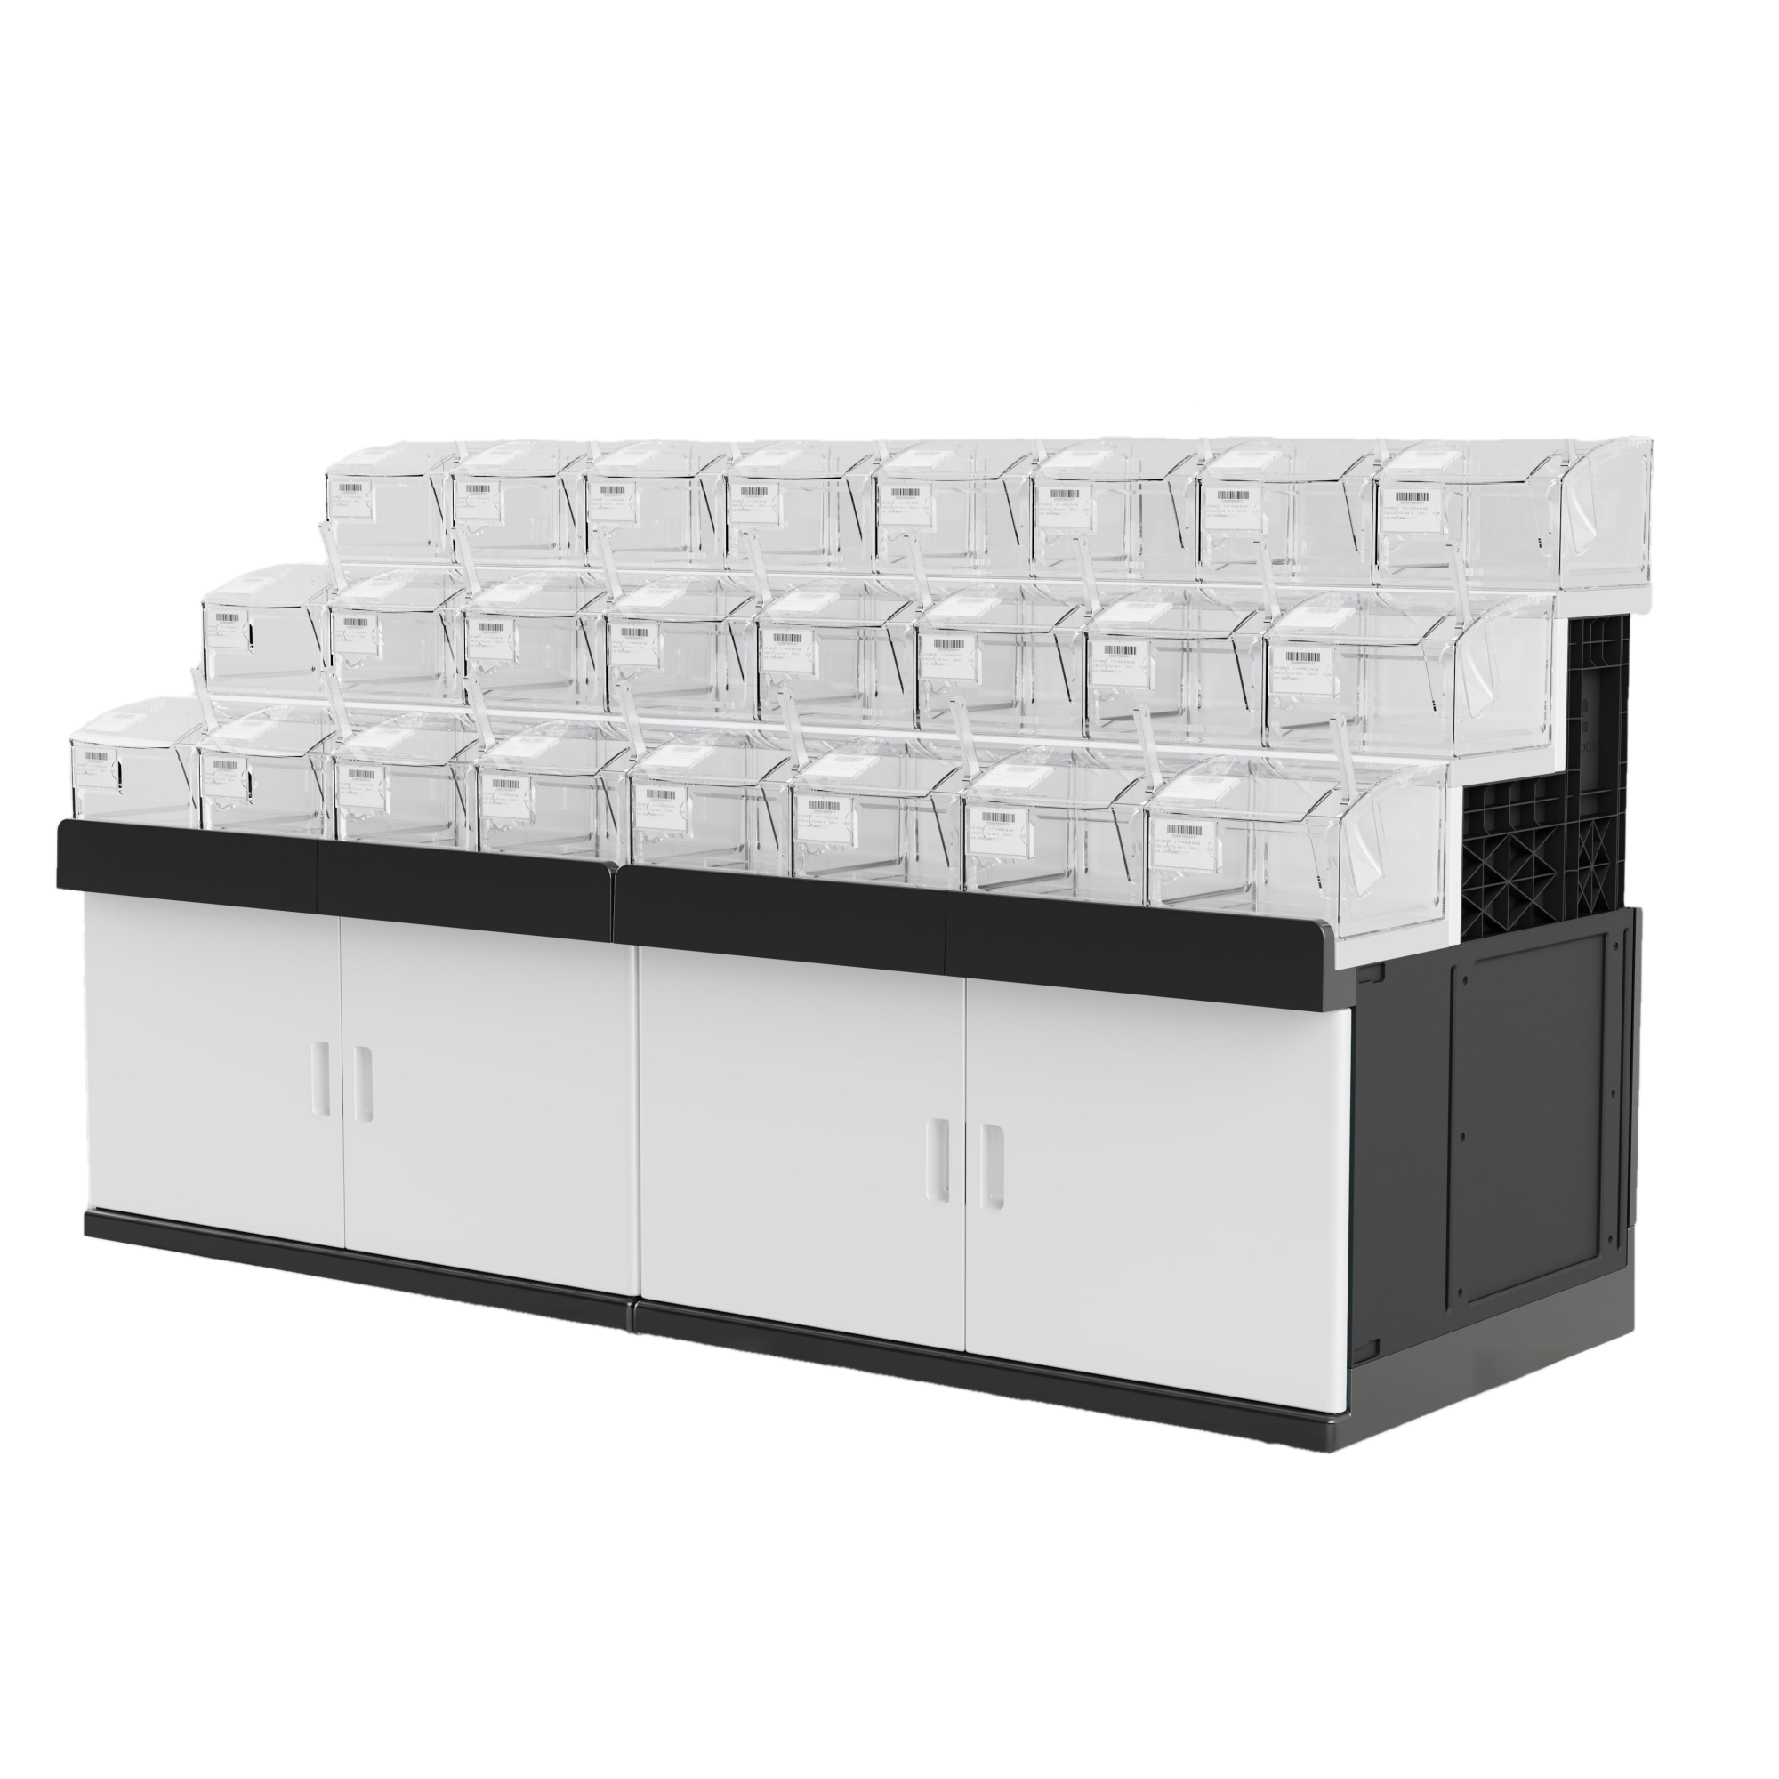
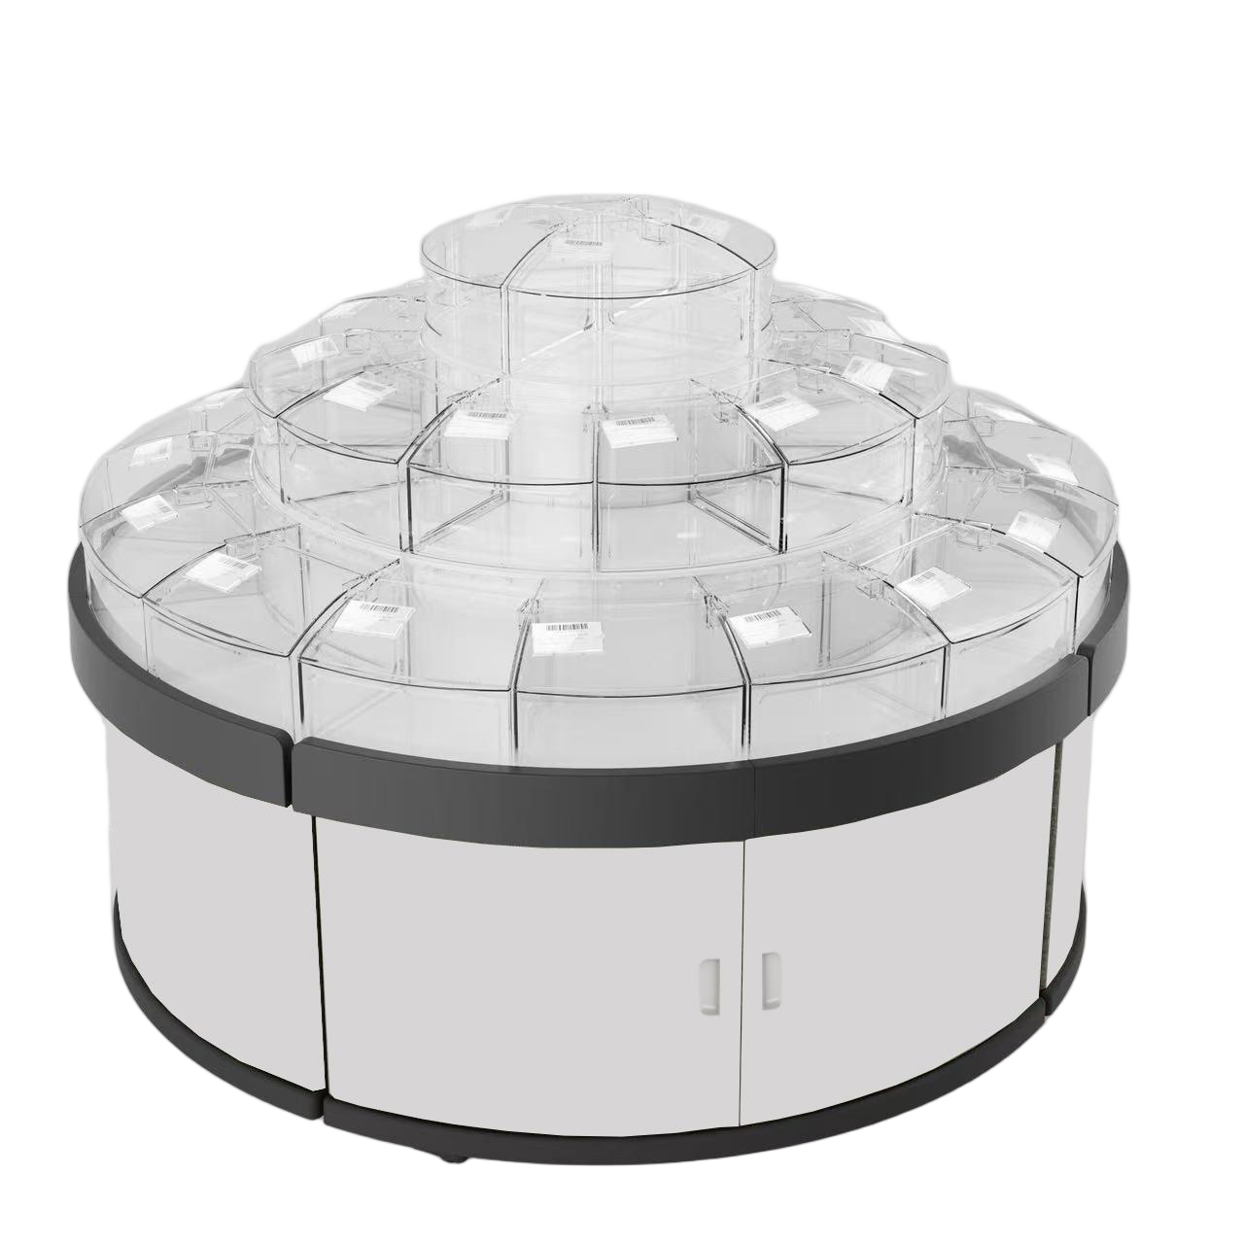

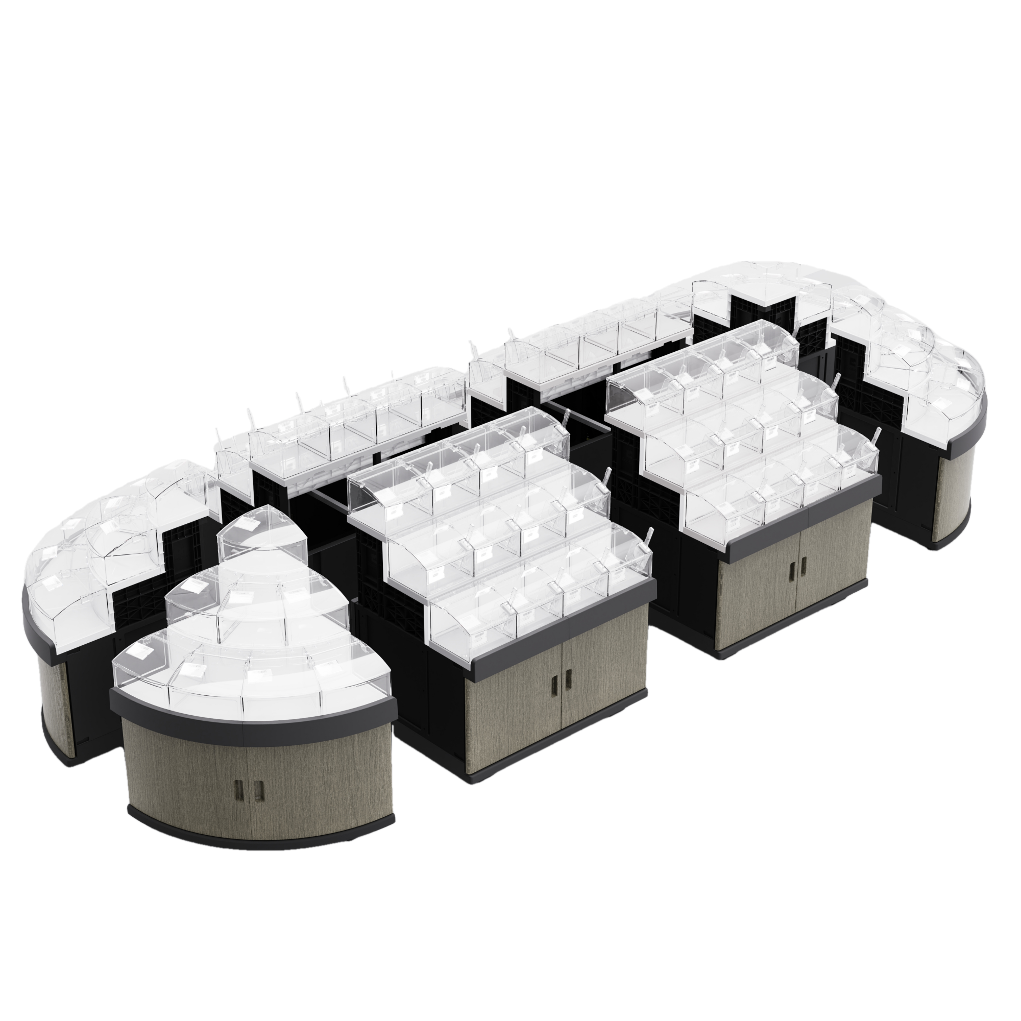
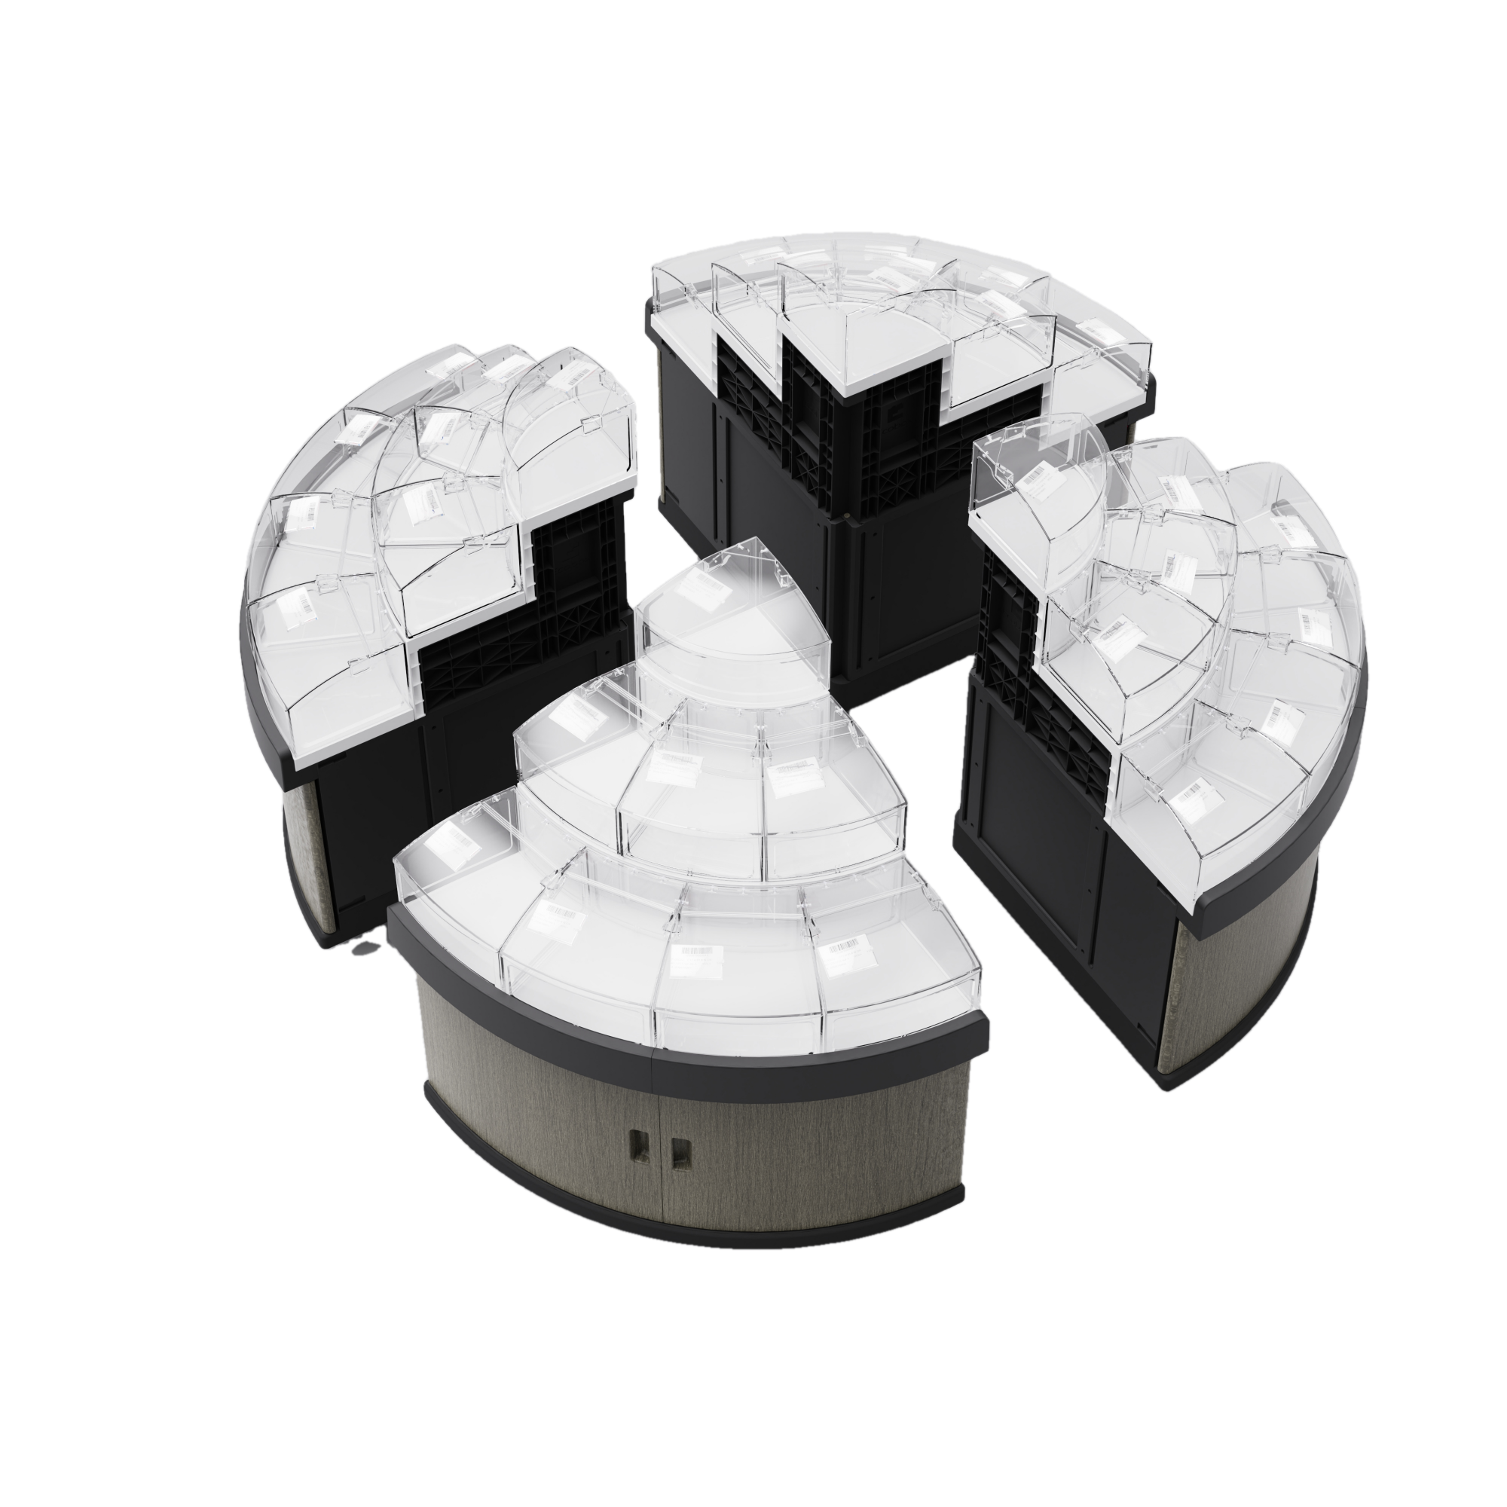
Combined Cabinets
GT-02
Combined Circular Cabinet
GT-01
Combined Side Cabinet
GT-01 and GT-02
Combined Island Display Cabinets

Slide 4
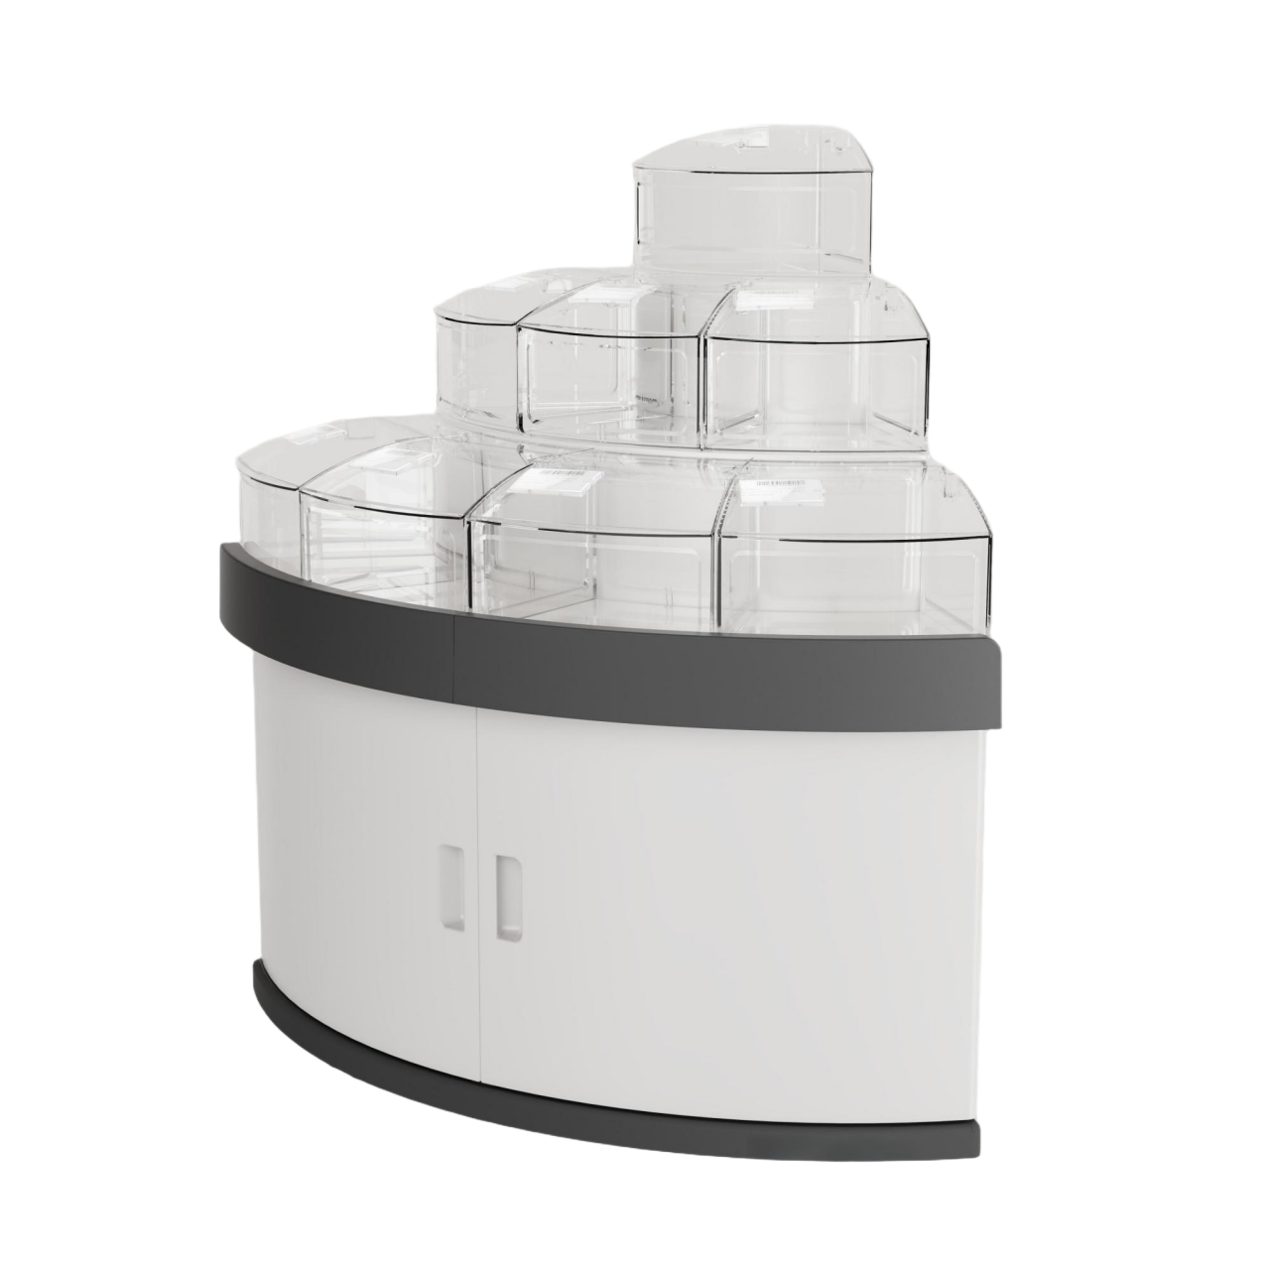


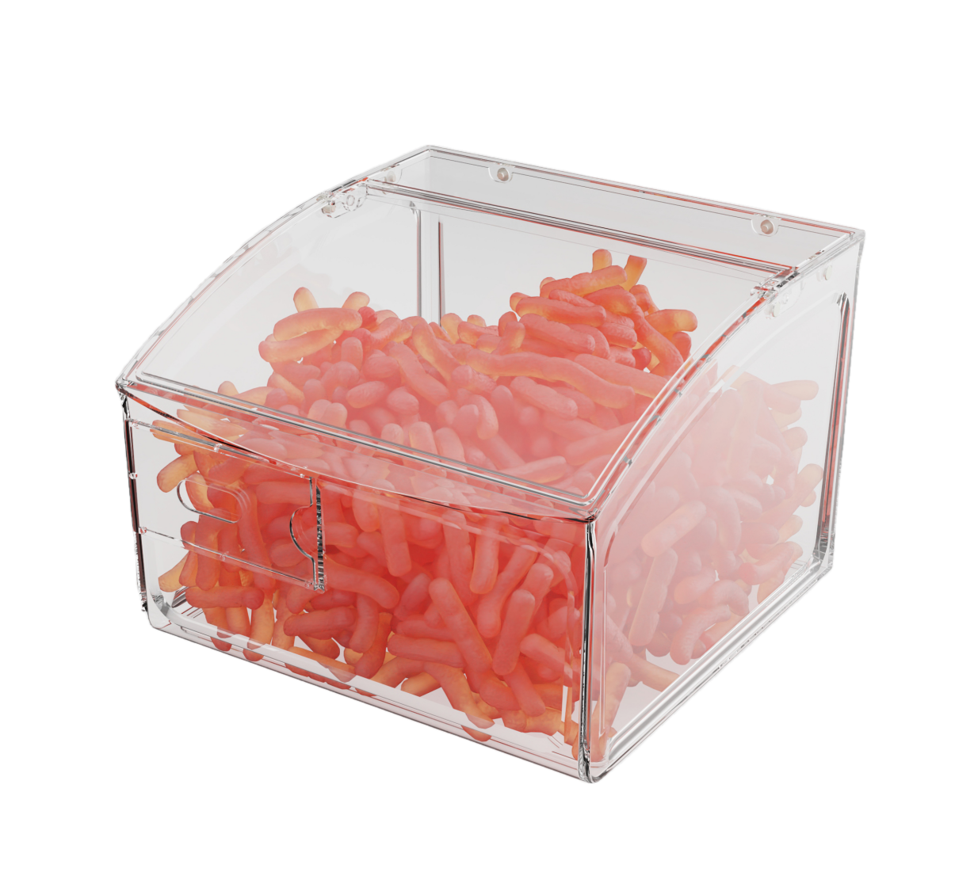
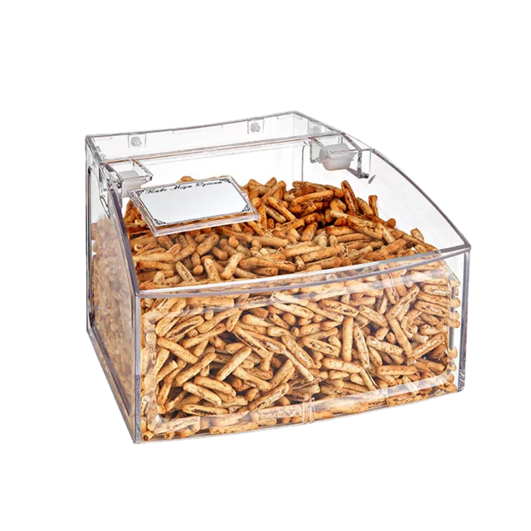
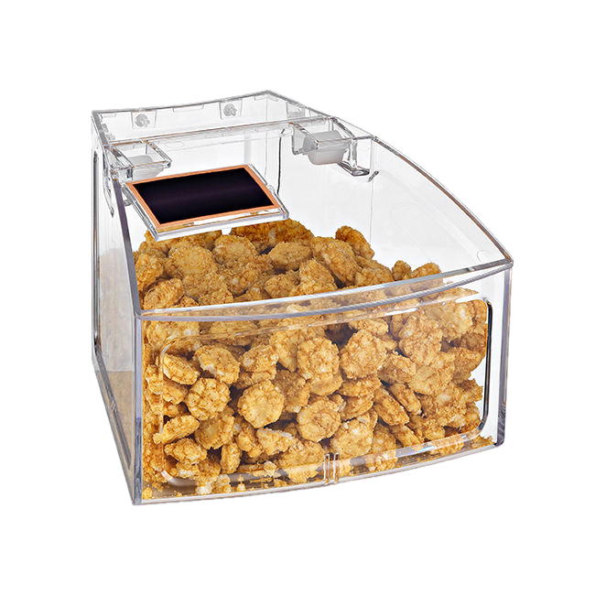

Combined Cabinet Details
GT-01 2 sets
GT-02 4 sets
SL-18 24 pcs for GT-01
SL-02 16 pcs
for GT-02 1st layer
SL-03 12 pcs
for GT-02 2nd layer
SL-04 (without lid) 4 pcs
for GT-02 3rd layer

Slide 5

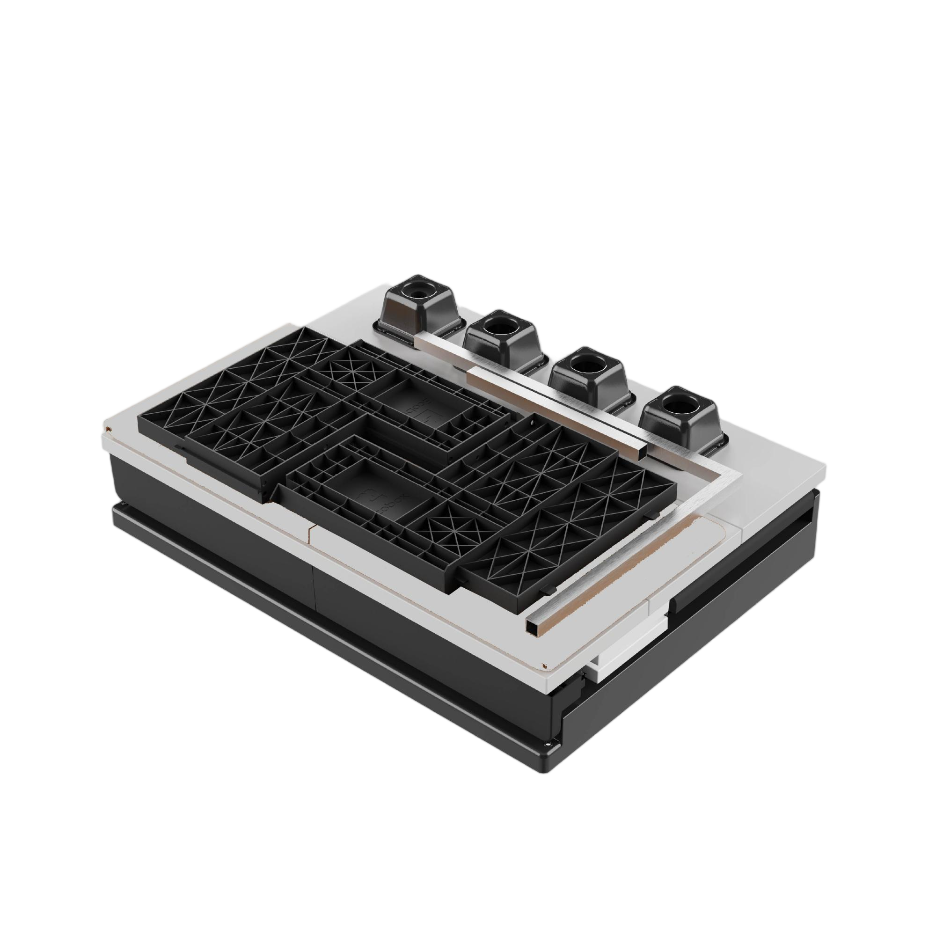
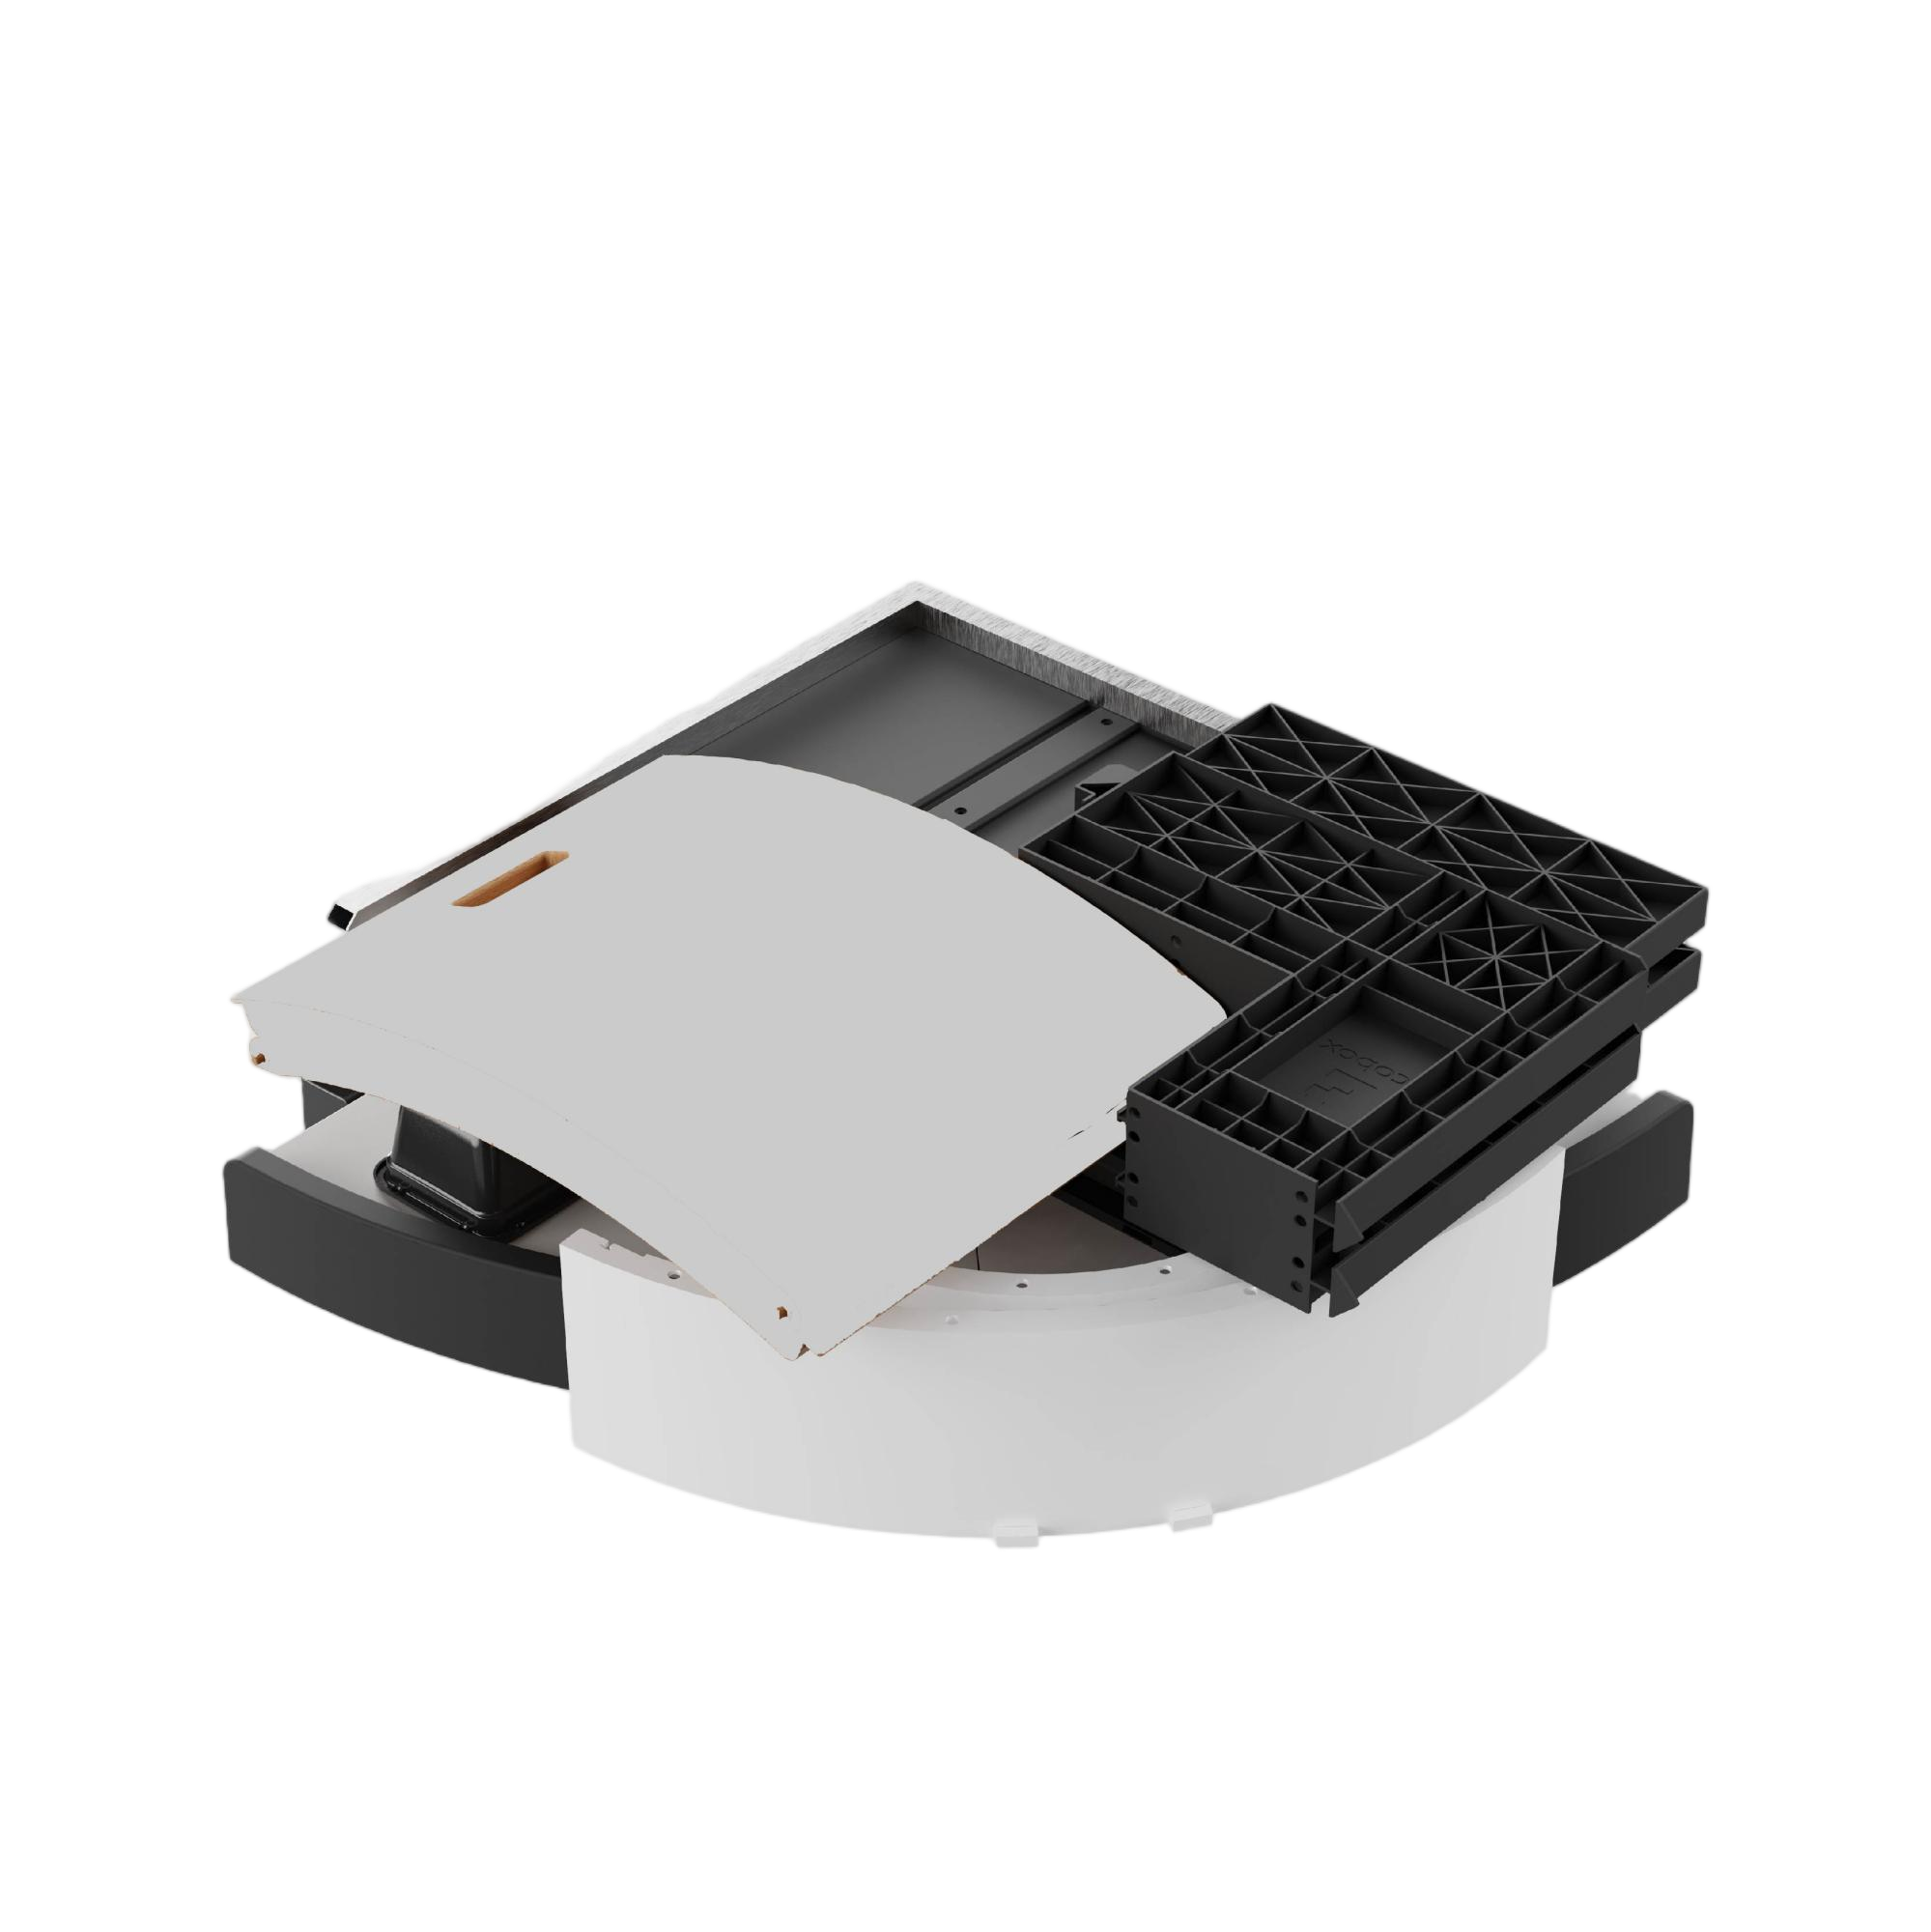
Highlight:Foldable packaging + easy installation
The cabinet can be packaged with disassembled and folded, also the installation process is simple.
The packaging volume is relatively reduced.

Slide 6
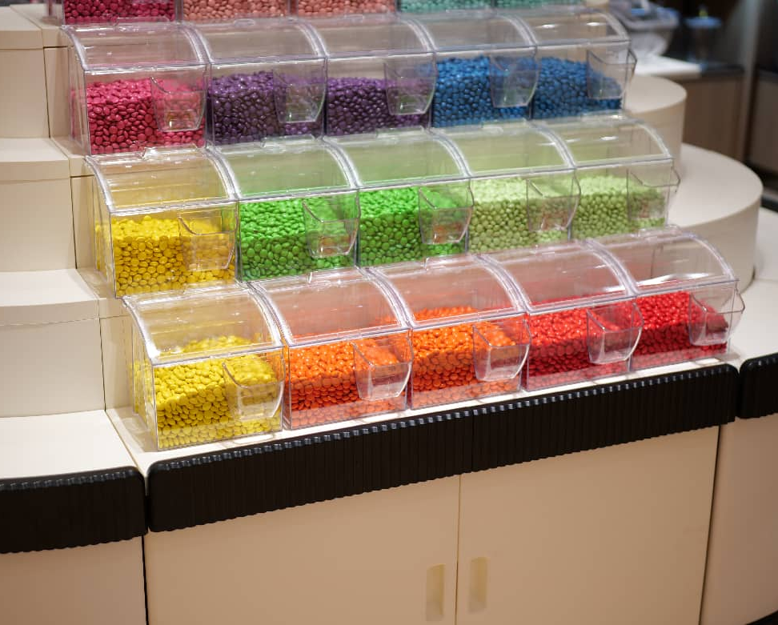
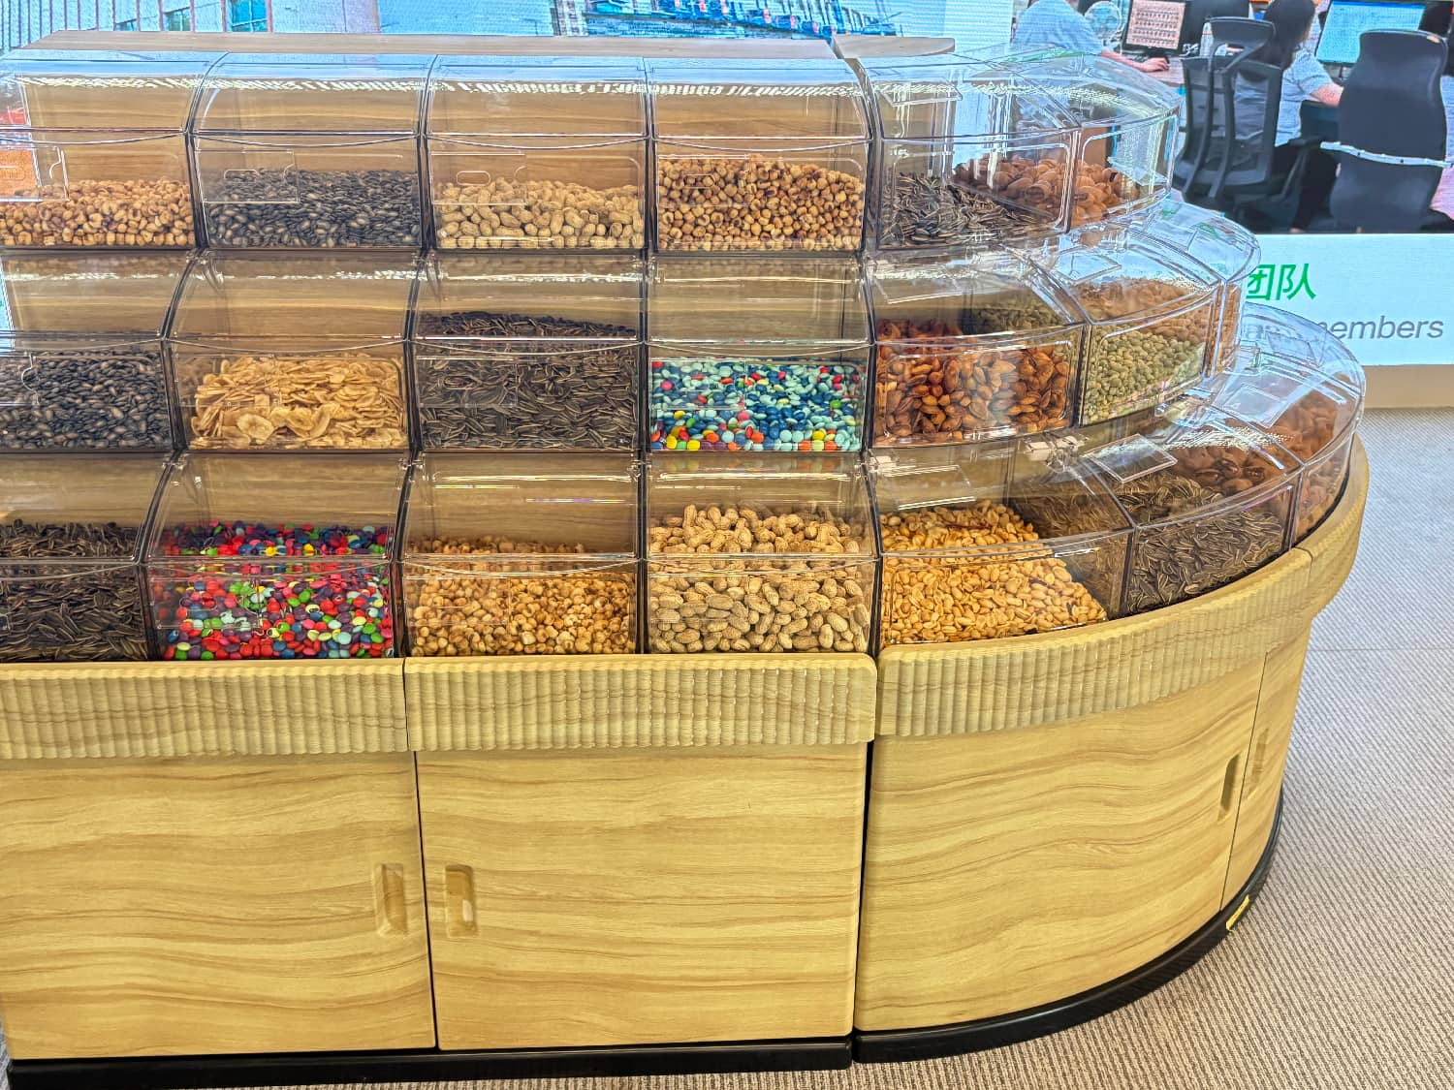
Actual Usage Scenario Diagram

Slide 7
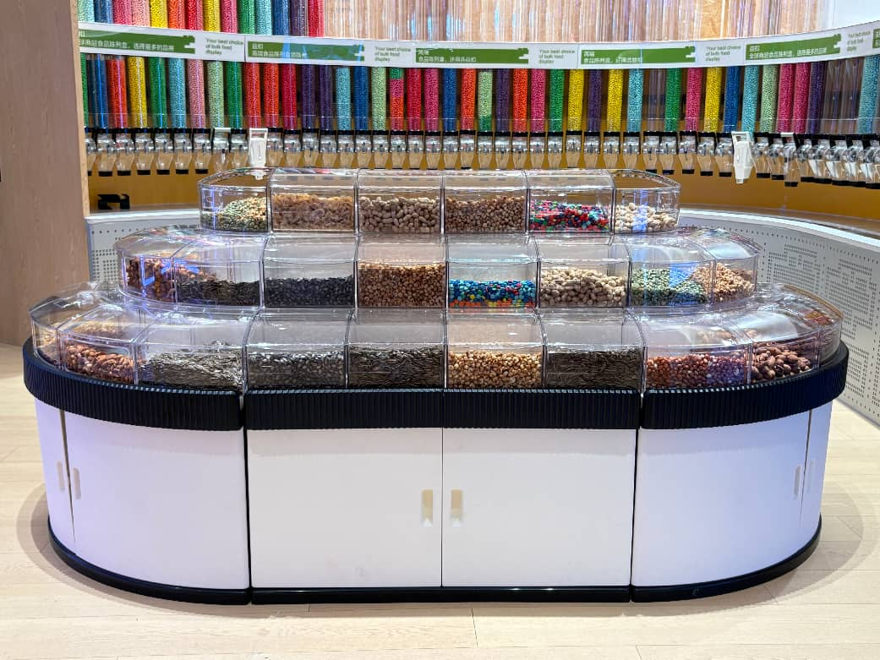
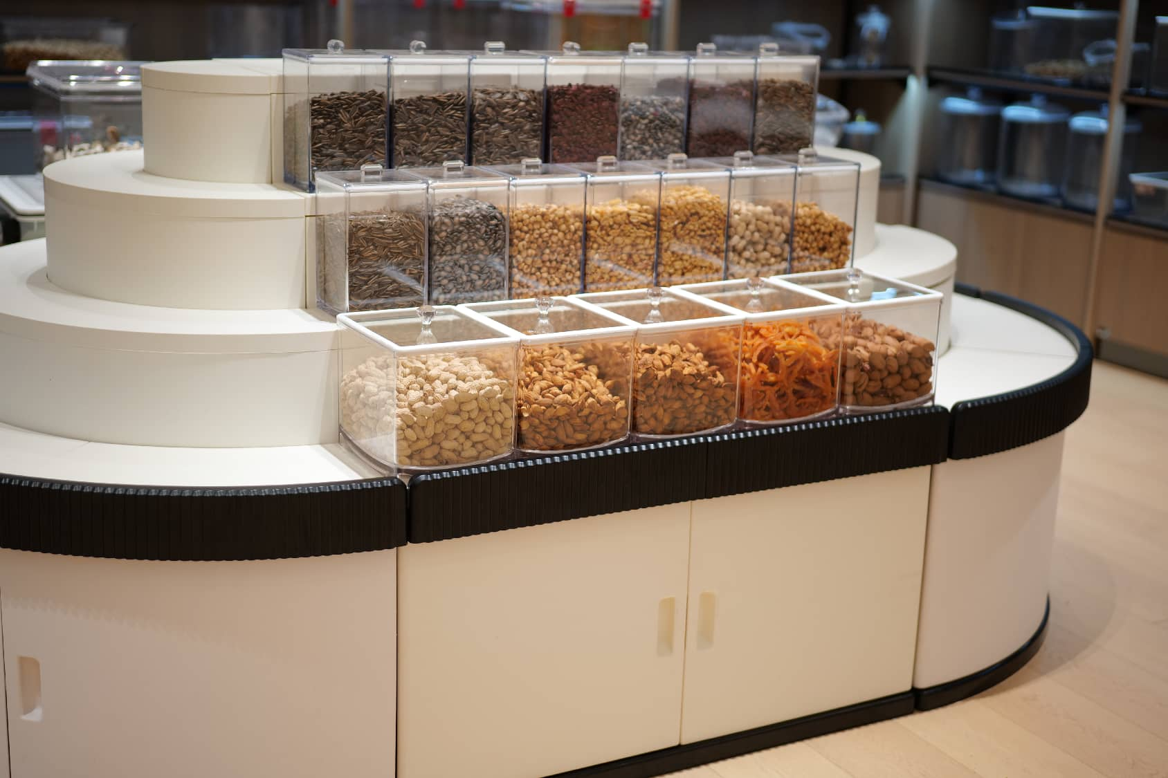
Actual Usage Scenario Diagram

Slide 8
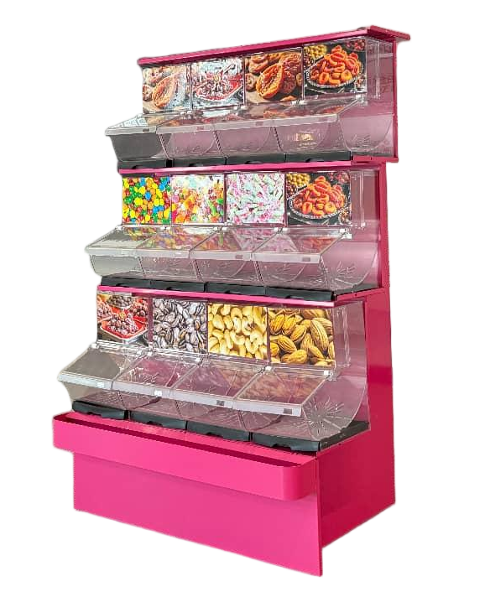
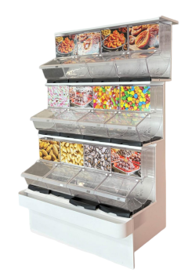
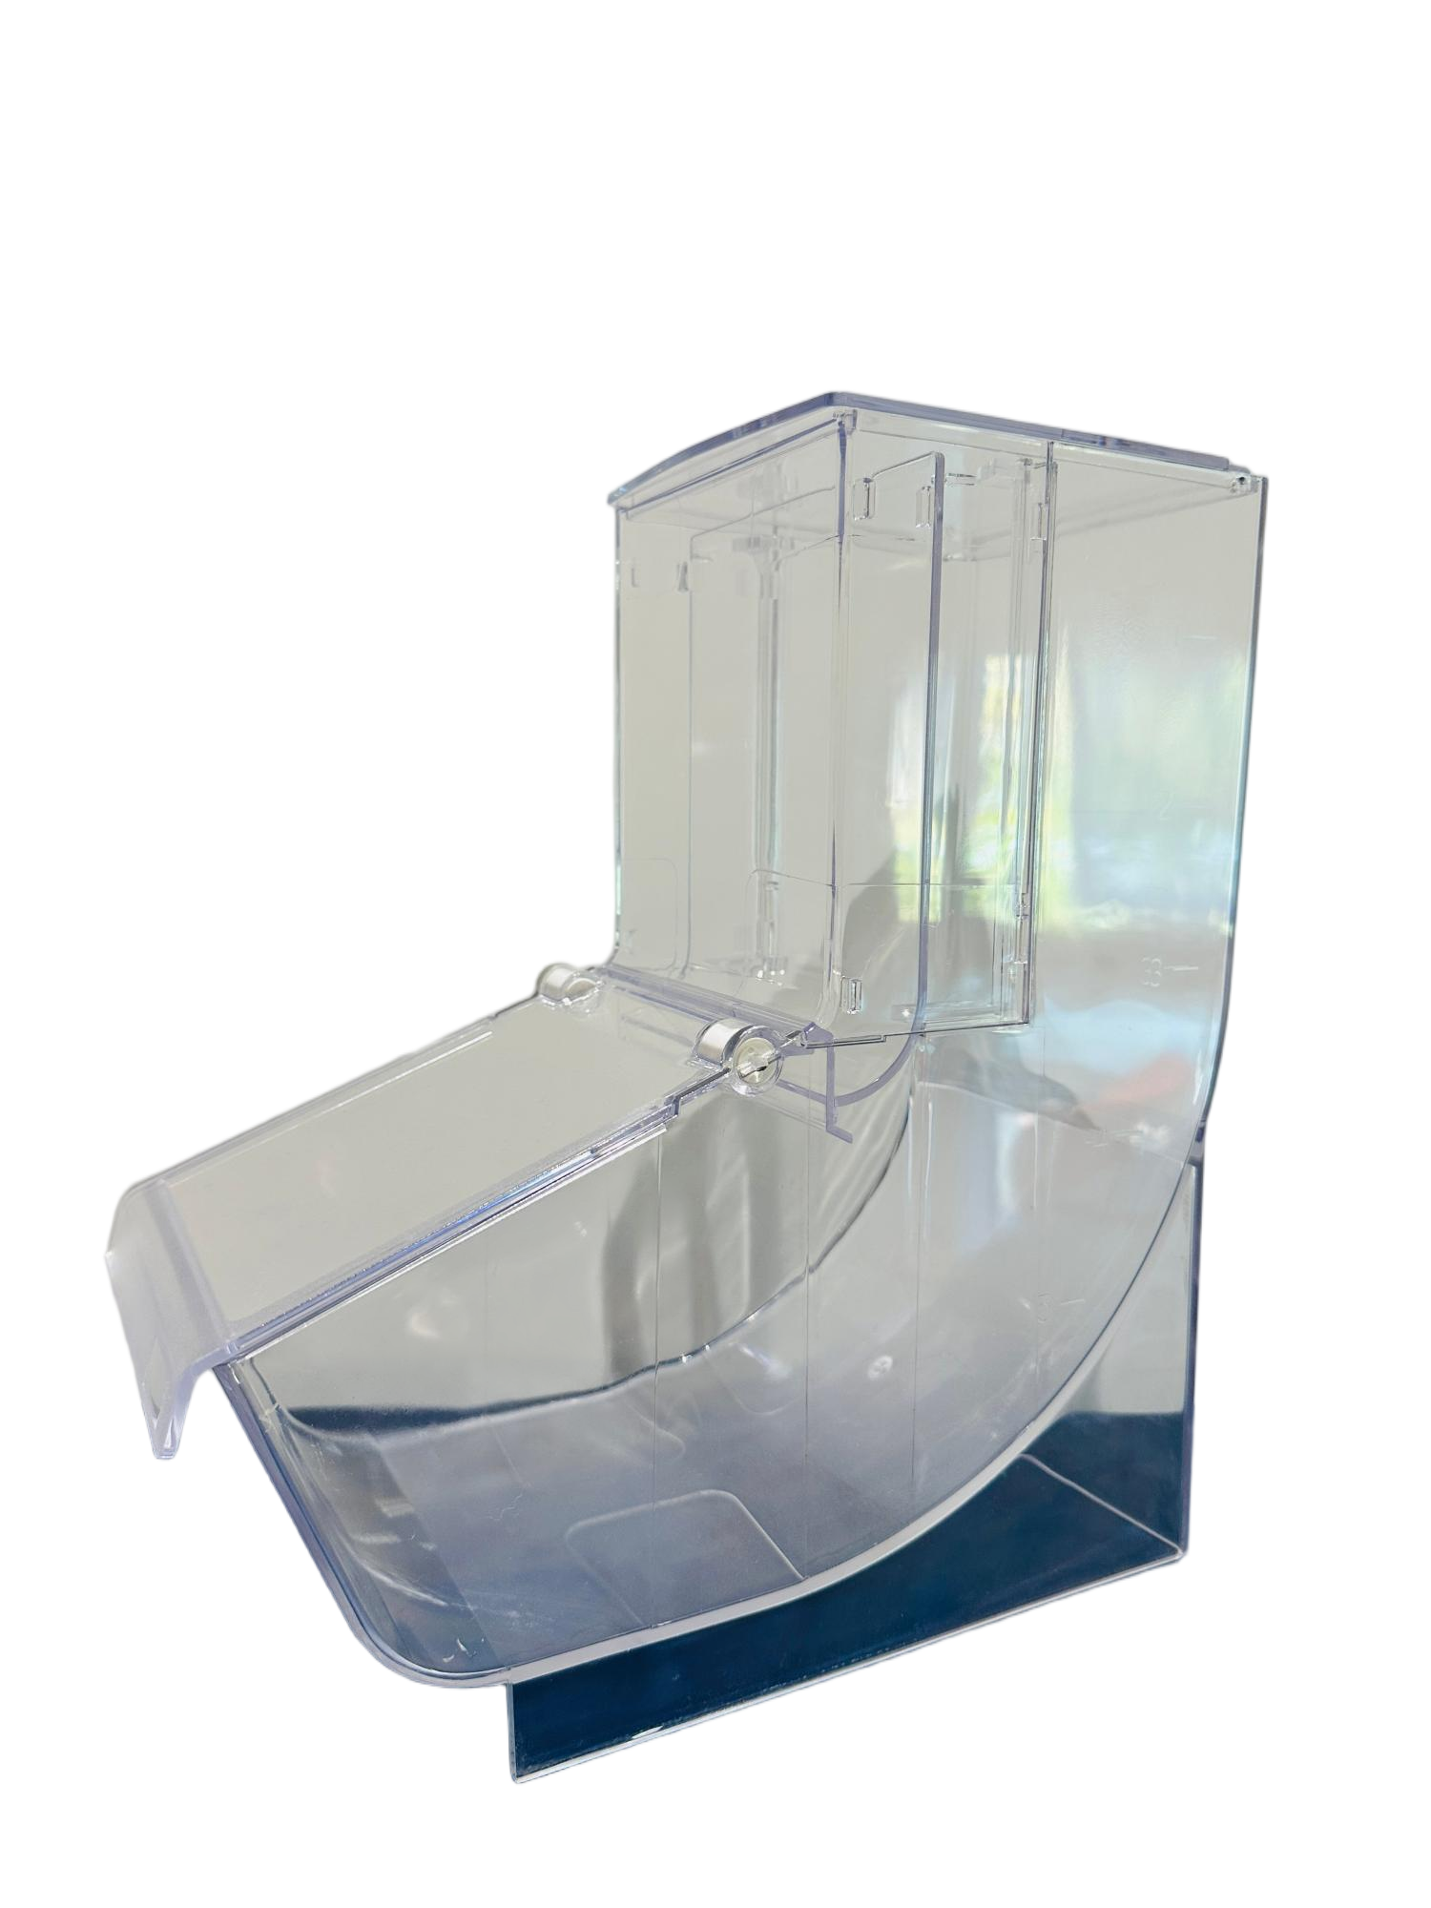
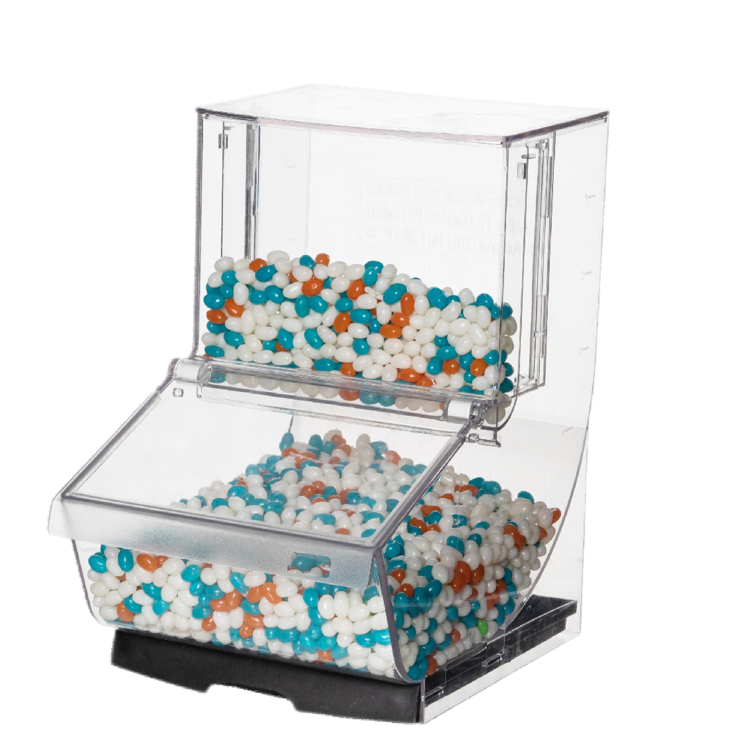
Iron Candy Display Stand
LD-03 12 PCS for one set TG-24
LD-07 18 PCS for one set TG-24
TG-24 Candy Stand
with Scoop Bin LD-03/LD-07

Slide 9
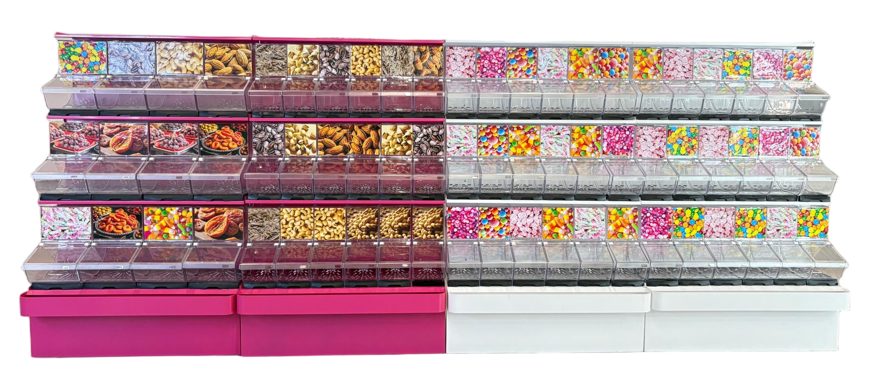
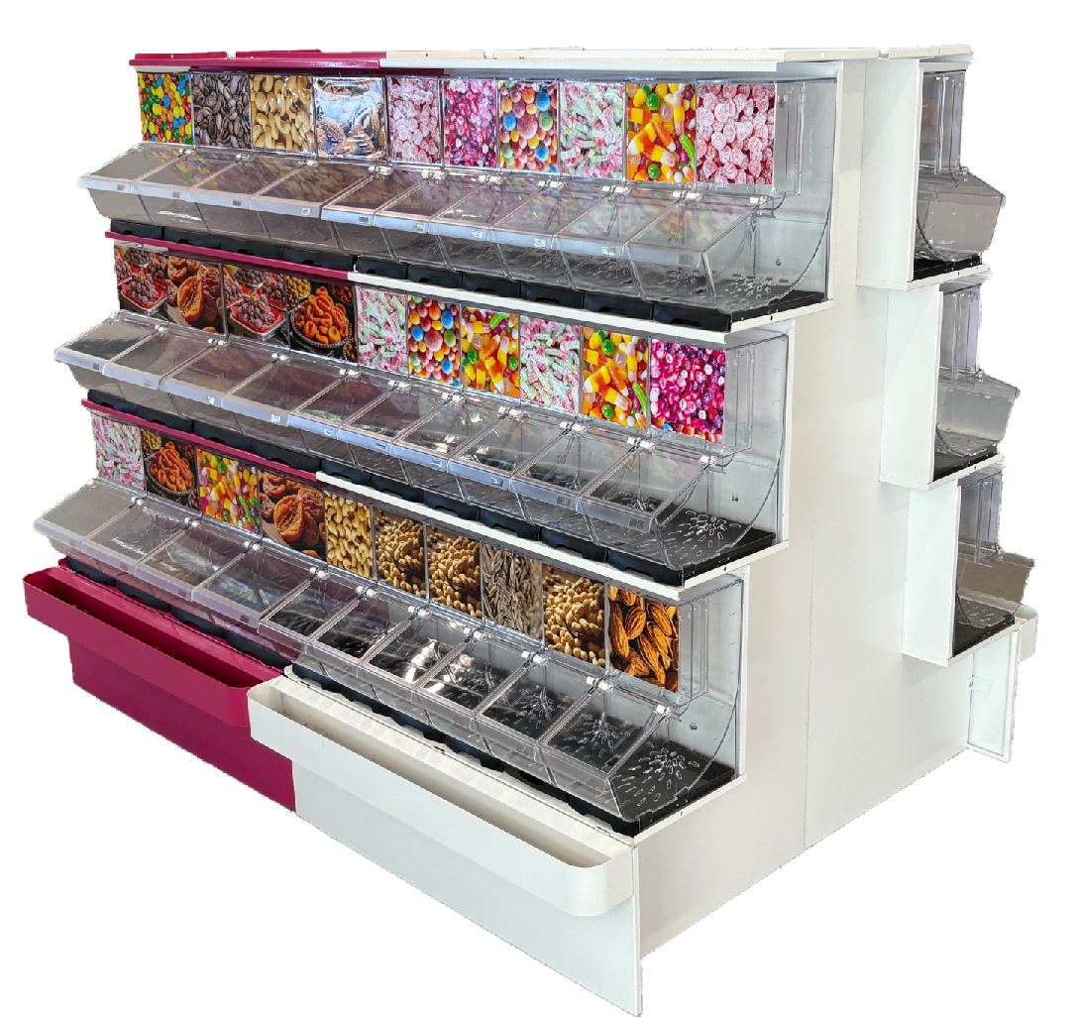
Combined Iron Candy Display Stand
Back-to-back Display
Side by side Display

Slide 10
Thanks for Watching
Author:Yura Wu
Contact Us:
Yura Wu (sales manager)
E-mail: sales@jxecobox.com
Mobile(WhatsApp/Wechat): +86 18779881046

